Slide 1


SECURE SOFTWARE DEVELOPMENT (SSD)
Diploma in ISF
Academic Year (AY) 20/21 – Semester 3 (April `20)
Week 6
Secure software Design – Part 2
Last Updated: 24/05/2020

Slide 2
Contents
Key Secure Design Principles
Mission 6.1: Security Design Techniques (Optional)
Authentication Design
Remote Learning Instructions
Mission 6.2: Razor Pages Security II

Slide 3
Remote Learning Instructions
Step 1
Read Secure Design Reading Materials
Watch and Read Authentication Design (Slides 4-9)
Read Key Secure Design Principles (Slide 10)
Step 2
Attempt Open Ended Question
More details in slide 11
Step 3
Do Mission 6.1
More details in slide 12

Slide 4
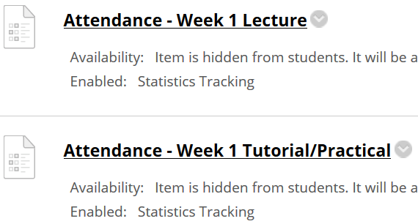
Important Details
VERY IMPORTANT
Visit MEL to start each week’s lesson. Learning materials will ONLY be released in MEL
Attendance Poll Attempt TWO attendance polls every week Starts Monday (9am) till Friday (11:59pm) Attendance :– Week x Lecture ( x refers to week number) Week x Tutorial/Practical Just click “Save and Submit”
Always lookout for announcements Do keep abreast of announcements in MEL
In light of the Covid-19 situation, your cooperation in adhering to the points mentioned is much needed and greatly appreciated.

Slide 5
Authentication Design
Authentication Design
Multi-Factor Authentication
Single Sign-On (SSO)
Federation

Slide 6

Multi-Factor Authentication
Multi-factor or the use of more than one factor to authenticate a principal (user or resource), therefore provides heightened security and is recommended.
Copyright @ https://www.youtube.com/watch?v=0mvCeNsTa1g

Slide 7

Multi-Factor Authentication
For example, validating and verifying one’s fingerprint (something you are) in conjunction with a token (something you have) and pin code (something you know) before granting access provides more defense in depth than merely using a username and password (something you know).
Copyright @ https://www.youtube.com/watch?v=07mRDyydCNY

Slide 8
Single Sign On (SSO)
SSO, wherein the principal’s asserted identity is verified once and the verified credentials are passed on to other systems or applications, usually using tokens, then it is crucial to factor into the design of the software both the performance impact and its security.
SSO simplifies credential management and improves user experiences and performance because the principal’s credential is verified only once.
Improper design of SSO can result in security breaches that have colossal consequences. A breach at any point in the application flow can lead to total compromise

Slide 9
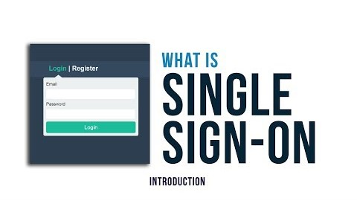
Single Sign On (SSO)
Improper design of SSO can result in security breaches that have colossal consequences. A breach at any point in the application flow can lead to total compromise
Copyright @ https://www.youtube.com/watch?v=kRGPKh3NgHU

Slide 10
Federation
Federation extends SSO across enterprises.
In a federated system, an individual can log into one site and access services at another affiliated site without having to log in each time or re-establish an identity.

Slide 11
Key Secure Design Principles
Least Privilege
Separation of duties
Defense-in-Depth
Fail Safe
Economy of Mechanism
Complete Mediation
Open Design
Least Common Mechanism
Psychological Acceptability
Leveraging Existing Components
Read Security Design Principles
Source: Official (ISC)² CSSLP CBK – 2nd Edition - Mano Paul

Slide 12
Key Secure Design Principles
Design Principles | Examples
Least Privilege | Use of accounts with non-administrative abilities, eg; instead of sysadmin account, use datareader account to execute database commands.
Separation of duties | Programmer should not be allow to review his/her own code.
Defense-in-Depth | Disallowing active scripting in conjunction with output encoding to defend against XSS attack.
Fail Safe | Account lockout mechanism
Economy of Mechanism | Single Sign On (SSO) illustrates simplification of user authentication. Keep it simple.

Slide 13
Key Secure Design Principles
Design Principles | Examples
Complete Mediation | Access requests need to be mediated each time, every time, so that authority is not circumvented in subsequent requests.
Open Design | Kerckhoff’s principle where all information about crypto system is public knowledge except the key.
Least Common Mechanism | Mechanisms common to more than one user or processes, should not be used.
Psychological Acceptability | Easy to use interface that process transaction transparently.
Leveraging Existing Components | Reuse of tested and proven, existing libraries and common components.

Slide 14
Open-Ended Question
Qn 1: Explain in your own words, how does psychological acceptability principle help in the design of a secure software?
Attempt the open-ended questions above.
Submit your answers in Teams group.
SSD-AY2021-xxx-Pxx → Week 6
Use “Conversations” tab under “SSD-AY1920-xxx-Pxx → Week 6” to discuss within your class group.

Slide 15
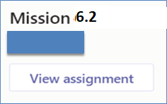
Mission 6.1: Razor Pages Security III (Individual)
Attempt the Razor Pages Security III practical
Click on “Files” tab and download the “Razor Pages Security 3 - Security Countermeasures.docx”
Submit detailed screenshots of your completed page in General→Assignment in Teams.
The screenshots must show the browser’s “Address Bar” to verify the application is running in your laptop.
Deadline: by End of Week 6
Penalty for late submission
If you got any issues or suggestions regarding Mission 6.1
Use “Conversations” tab under “SSD-AY1920-xxx-Pxx → Week 6” to discuss within your class group.
Tutors would also monitor these “Conversations”.

